Slide 1
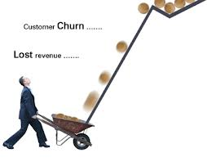
CAPSTONE EDA PROJECT TELECOM CHURN ANALYSIS
BY - Akashpati Mishra

Slide 2
CONTENT:
Project Summary
Problem Statement
Feature Breakdown
Data Summary
Exploratory Data Analysis
Solution To Business Objective

Slide 3
PROJECT SUMMARY:
Customer churn is a big problem in Telecom industry and will effect on the revenues of the companies.
The telecommunications industry experiences an average of 15-25% annual churn rate and it costs 5-10 times more to acquire a new customer than to retain an existing one that's why customer retention has now become even more important than customer acquisition.
Therefore, finding those factors that increase customer churn is important to take necessary actions to reduce this churn.
The main goal of our project is to develop an understanding of the cause of customer churn which assists telecom operators to predict customers who are most likely subject to churn, and what to do to retain the most valuable customer.

Slide 4
PROBLEM STATEMENT:
Orange S.A., formerly France Telecom S.A., is a French multinational telecommunications corporation. The Orange Telecom's Churn Dataset, consists of cleaned customer activity data (features), along with a churn label specifying whether a customer cancelled the subscription. Explore and analyze the data to discover key factors responsible for customer churn and come up with ways/recommendations to ensure customer retention.

Slide 5
KEY OBJECTIVE:
Analyze the key reason responsible for customer churn.
Minimize company cost by retaining customer by analyzing key factor responsible for there churn.
Give proper suggestions to improve retention of customer and increasing profit.

Slide 6
FEATURE BREAKDOWN:
STATE: 51 Unique States name.
Account Length: Length of The Account.
Area Code: Code Number of Area having some States.
International Plan: Yes Indicate International Plan is Present and No Indicates no subscription for International Plan.
Voice Mail Plan: Yes Indicates Voice Mail Plan is Present and No Indicates no subscription for Voice Mail Plan.
Number vmail messages: Number of Voice Mail Messages ranging from 0 to 50.
Total day minutes: Total Number of Minutes Spent in Morning.
Total day calls: Total Number of Calls made in Morning.
Total day charge: Total Charge to the Customers in Morning.
Total eve minutes: Total Number of Minutes Spent in Evening
Total eve calls: Total Number of Calls made r in Evening.
Total eve charge: Total Charge to the Customers in Morning.
Total night minutes: Total Number of Minutes Spent in the Night.
Total night calls: Total Number of Calls made in Night.
Total night charge: Total Charge to the Customers in Night.
Customer service calls: Number of customer service calls made by customer.
Churn: Customer Churn, True means churned customer , False means retained customer.

Slide 7
DATA SUMMARY:
NUMERIC VARIABLE
DECISION VARIABLE
Area Code
Number vmail messages
Total day minutes
Total day calls
Total day charge
Total eve minutes
Total eve calls
Total eve charge
Total night minutes
Total night calls
Total night charge
Customer service calls
Total intl calls
Total intl charge
Total Intl min
Churn
CATEGORICAL VARIABLE
STATE
International Plan
Voice Mail Plan
NOMINAL VARIABLE
Account Length

Slide 8
DATA SUMMARY
Rows – 3333
Columns- 20
3 Categorical var
No missing and No duplicate value
12 Numerical variable
1 Nominal variable
1 Decision variable(bool)

Slide 9
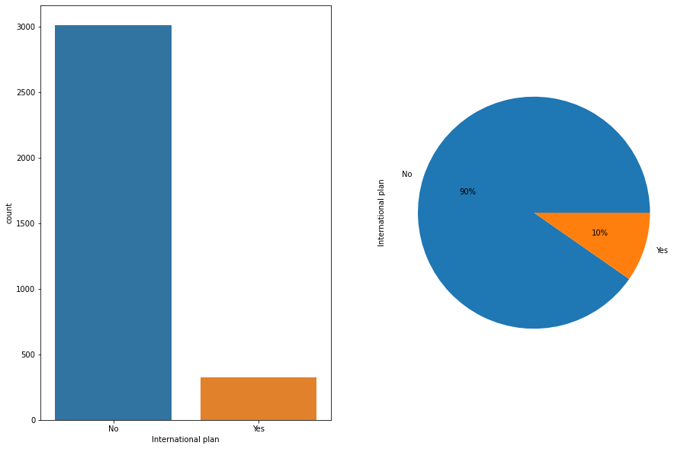
EDA:
UNIVARIATE ANALYSIS ON CATEGORICAL DATA
International plan
Only ~10% had taken International plan
out of total data.
Out of 3333 only 323 had taken
international plan.

Slide 10
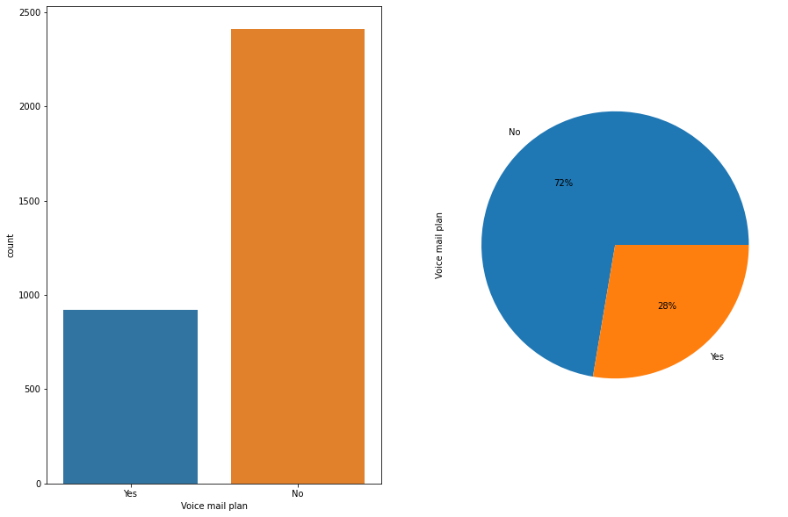
Voicemail Plan
Out of 3333 only 922 had taken Voicemail plan.
Only 28% customer had taken Voicemail plan

Slide 11
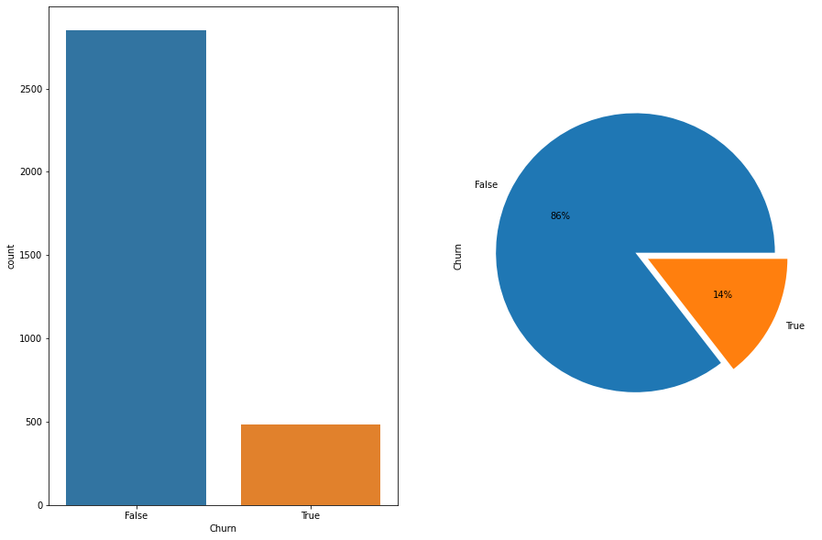
Churn:
483 customers were churned out of Total
3333.
~14% customers were churned which we have to make all possible way to retain them for increasing company profit.

Slide 12
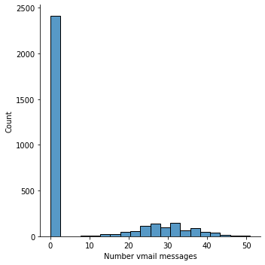
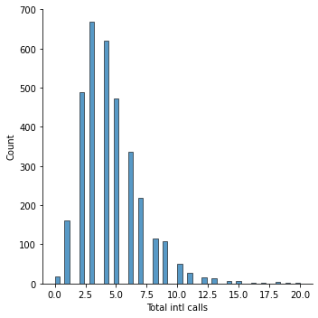
Number of Voicemail & Total International calls
Customers having voicemail between 20-40 is high
No. Of international calls above 10 is very low.

Slide 13
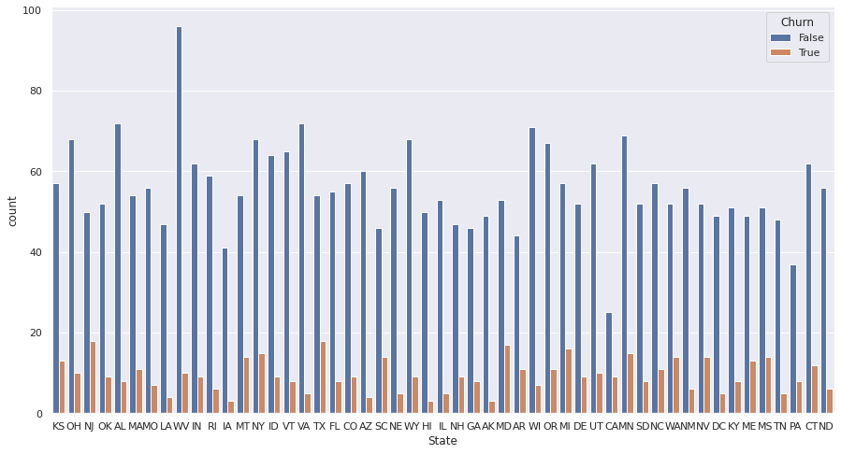
BIVARIATE ANALYSIS- Churn VS States
As we se NJ is highest churned state out of all states and HI is the lowest churned states.

Slide 14
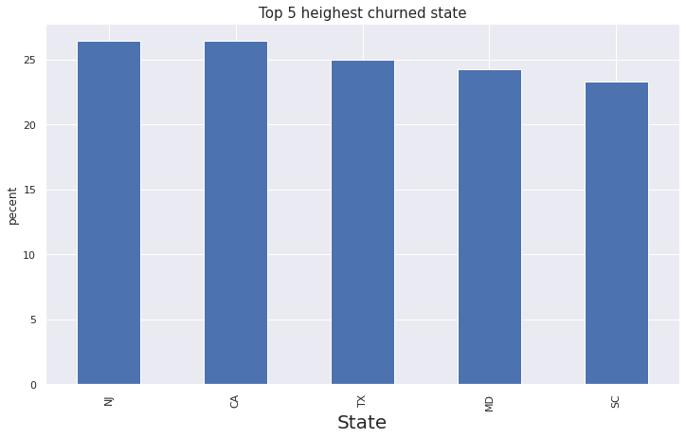
Top 5 most churned States
As we see [NJ, CA, TX, MD, SC]
were the top 5 most churned
States.
Our focus is more on top churned states .
Reason for churning may be due to lower network connection in
that area .
It need to improve network connectivity in highest churning
states.

Slide 15
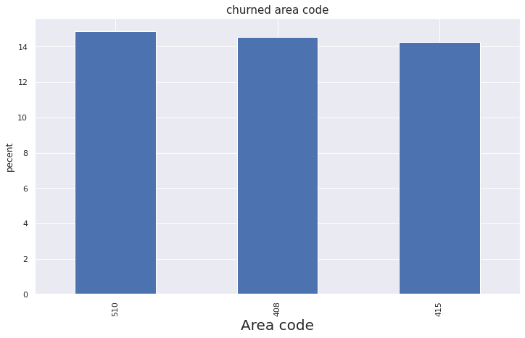
Area Code VS Churn
There are only 3 unique area code
As we see churn percentage for all Area Code is near about same
So we did not able to find any relationship between Area Code and churn

Slide 16
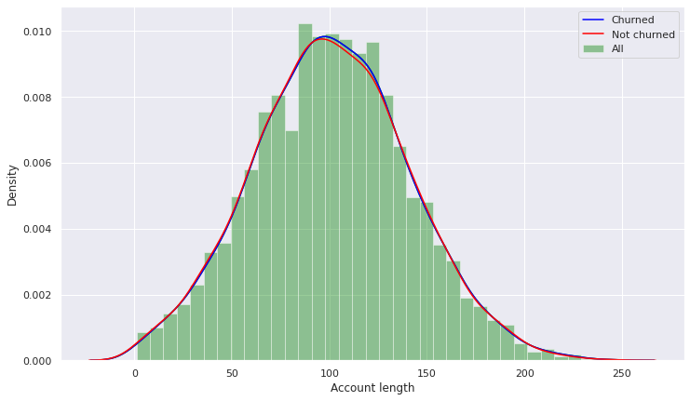
Account Length VS Churn
As we see there is no sign of customer are leaving because of account length.

Slide 17
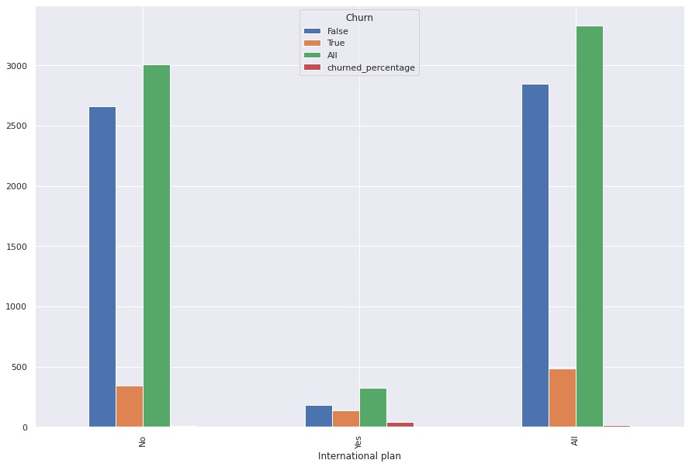
International plan VS Churn
This is a plot of International plan
VS churn.
As we see customer who having international plan were churning more.

Slide 18
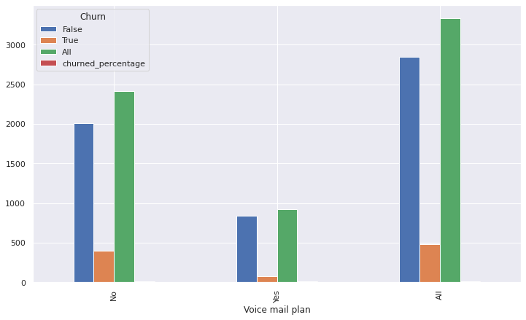
Voicemail plan VS Churn
This is a plot of voicemail plan VS churn.
As we see customer who do not have voicemail plan were churning more and one who have were churning less.

Slide 19
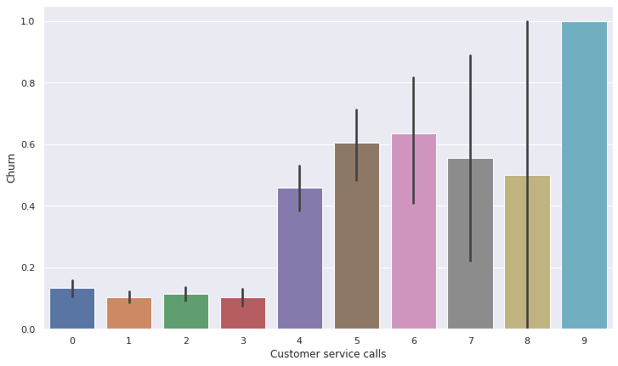
Customer service call VS churn
This is a plot of customer service call vs churn.
As we see customer were churning more when customer service call were more than 3.

Slide 20
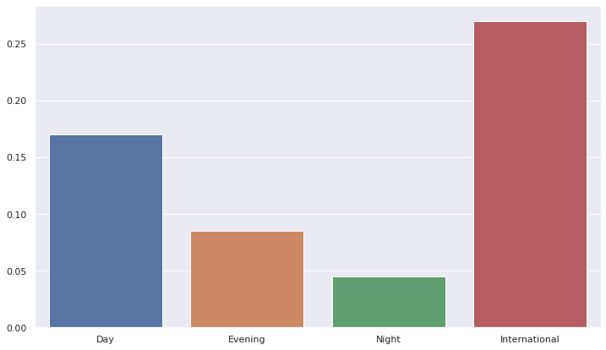
Day, Eve, Night, International VS charge rate:
This is a plot for comparing different charge rate.
As we see International charge rate were much more higher than other one.
Night charge rate is lowest of all.

Slide 21
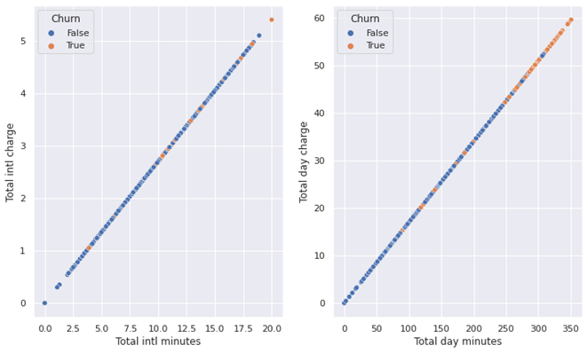
Multivariate Analysis
Intl min VS Intl charge VS churn
Day min VS day charge VS churn
After 10 intl min churn is higher.
After 240 day min churn in higher.

Slide 22
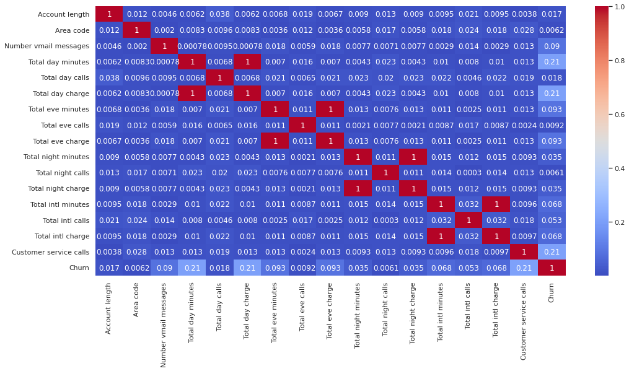
Correlation Matrix:

Slide 23
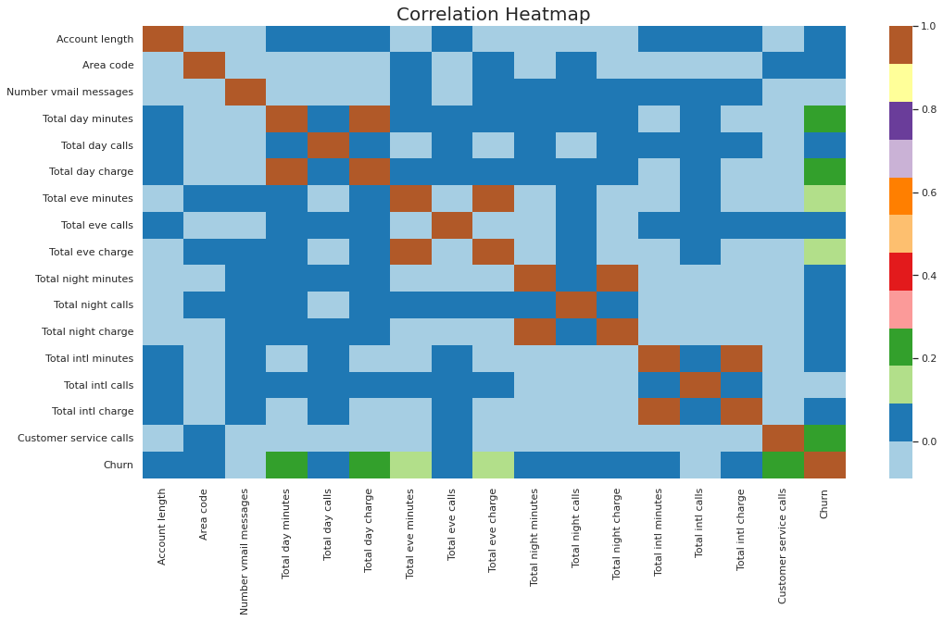
Correlation Heatmap:

Slide 24
Conclusion:
we stated data analyzing with univariate in which we seen different distributions of all data. Then we comes on bivariate analysis in which we different categorical and numerical variables with churn found out that top churned states were [ NJ, CA, TX, MD, SC].
Then we see voicemail plan and international plan analysis with churn and get result that who have voice mail plan churned less. and the data who is having international plan were churning more.
when I analyze customer call then saw that more than 3 customer call were churning more.
when I compare day, eve ,night and international call then I saw that international charge rate is higher than all the other charge rate.
when I compare total day minute with churn then comes to know that more than 240 day min churning were high.

Slide 25
Solution to business Objectives:
Focus on top churned state first. Improve network connection as this may be a problem for churning customer.
Area code have not that much role. we can neglect area code.
Improve customer service call center response may be customer query can't resolve that's why they were calling to customer again and again and did not satisfied with response then churn.
Focus on customer who had taken international plan . As they were churning more in comparison to who had not taken plan and try to revise plan may reduce plan price little bit for customer retention.

Slide 26
Solution to business objectives continues….
Give some discount offer after certain min day call because as day call increases after 240 min. our churning rate is also increase and we were loosing our valuable customers.
We did not able to analyze any valuable information with account length.
Focus on customer who did'nt picked voice mail plan as there churning rate is high.

